Slide 1
Reinforcement Learning DIY Platform
B.Tech. Project Final Presentation
Dhruv Chadha and Shashwat Raghuvanshi
Under the guidance of Dr. Aruna Tiwari and Dr. Kapil Ahuja
Notes:
Good Afternoon
Over next 15 min –
1) Tell you about platform through slides
2) Demo

Slide 2

Reinforcement Learning – Solving sequential decision making problems using AI
Notes:
Not supervised – classification/prediction
Not unsupervised – not trying to find patterns in data
In fact, there is no data at all.
Reward/Punishment for desired/undesired behaviour – learns eventually – like pets

Slide 3
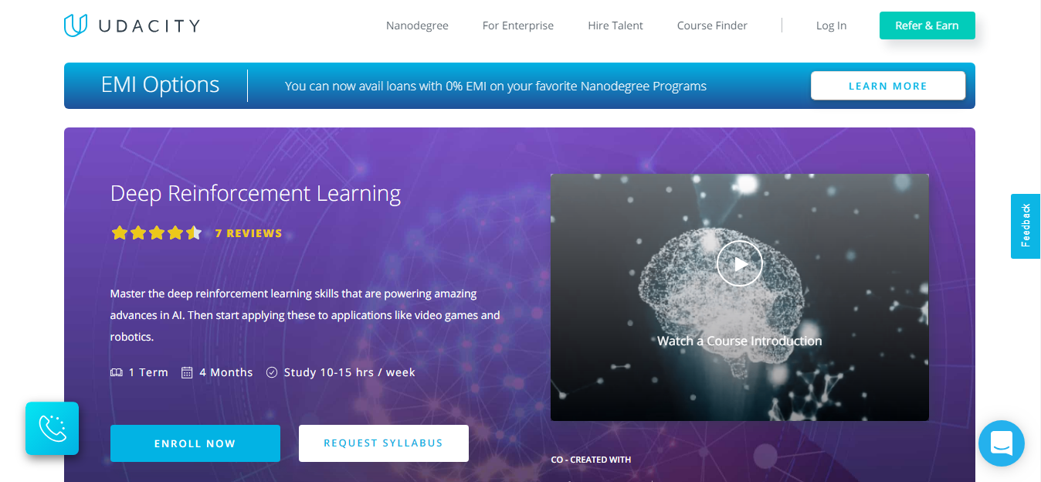
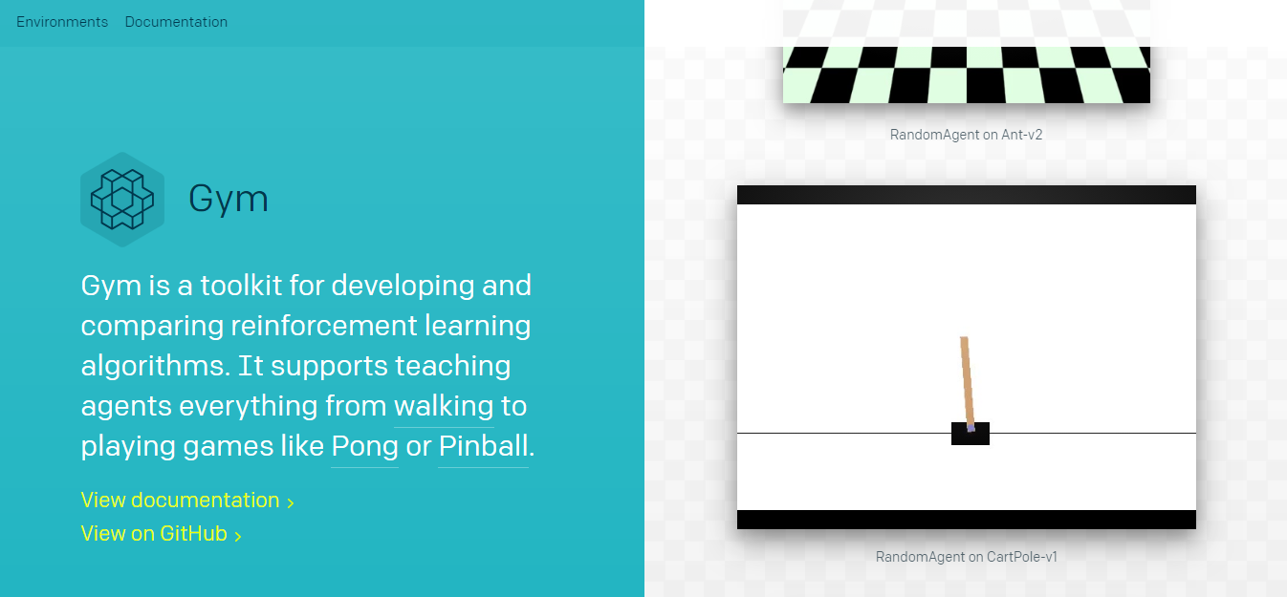
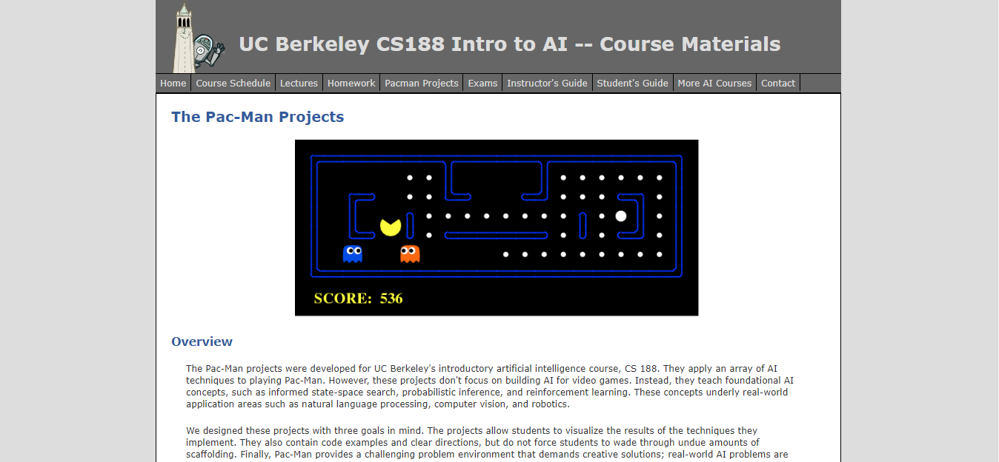
Target Problem
Lack of good and intuitive Reinforcement Learning tutorials online
OpenAI’s Gym Environment
Advantage | Disadvantage
Provides standardization of training environments used in publications | No study material to learn concepts
Udacity’s Deep Reinforcement Learning Nanodegree
Advantage | Disadvantage
Good course content coverage and qualified instructors. | Costs ~Rs. 50000
UC Berkeley’s ‘The Pac-Man Projects’
Advantage | Disadvantage
Covers a variety of AI techniques to play Pacman. | Does not go into the depths of Reinforcement Learning concepts, and covers limited algorithms.
Notes:
CartPole

Slide 4

P.E.A.R.L.
Platform to Explore Algorithms in Reinforcement Learning

Slide 5
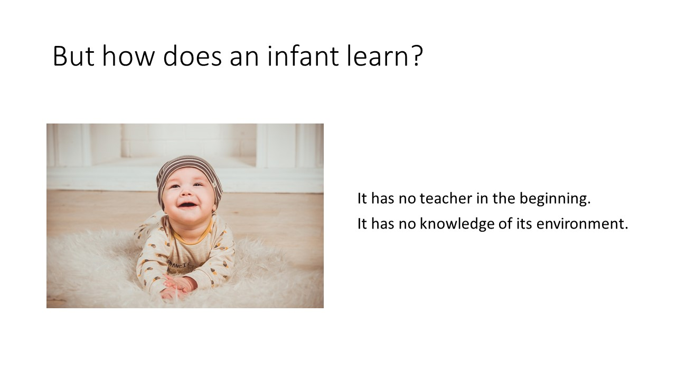
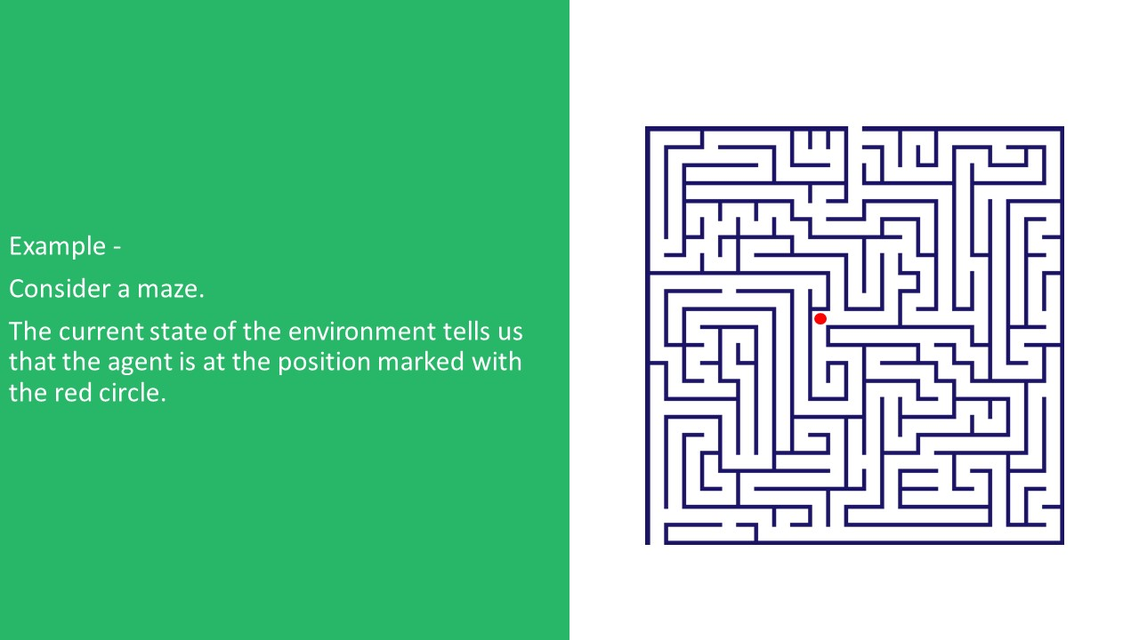
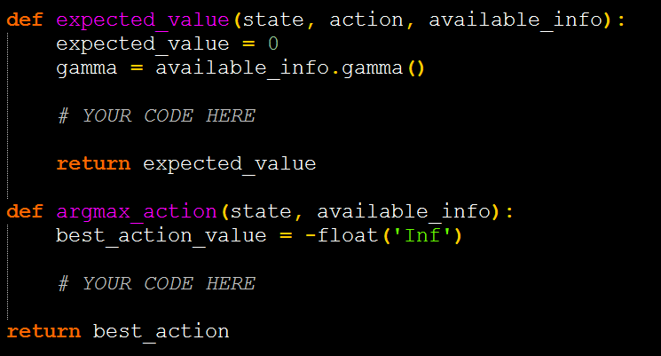
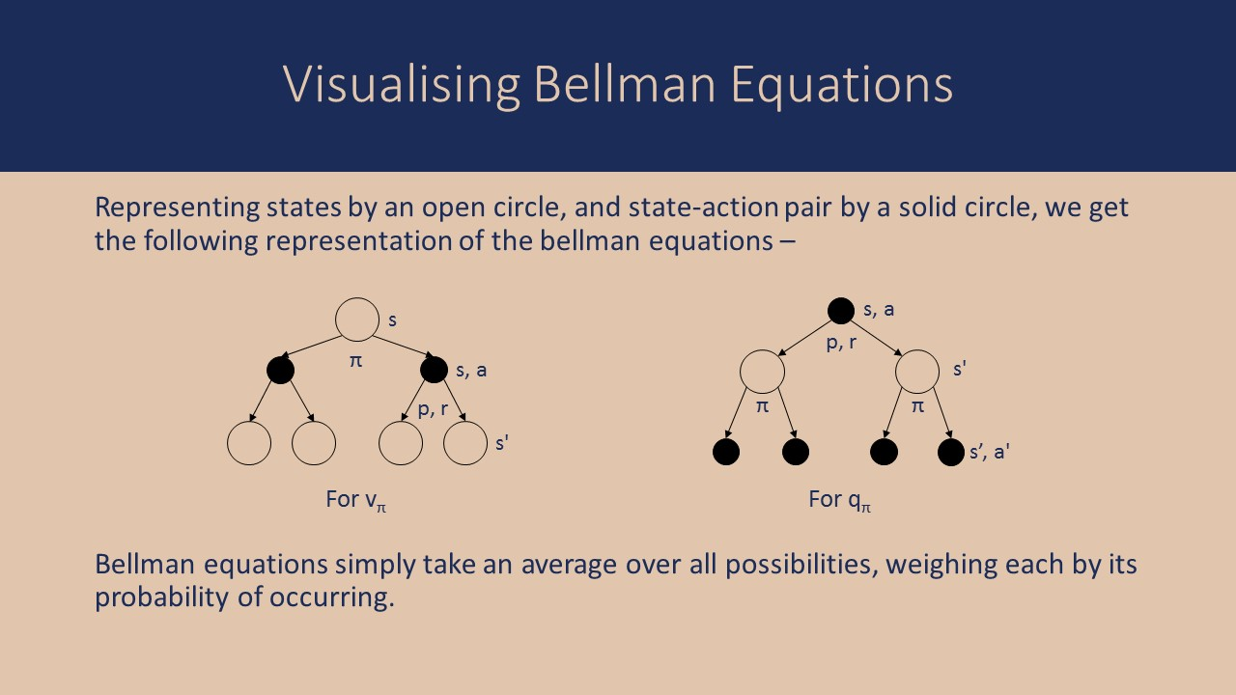
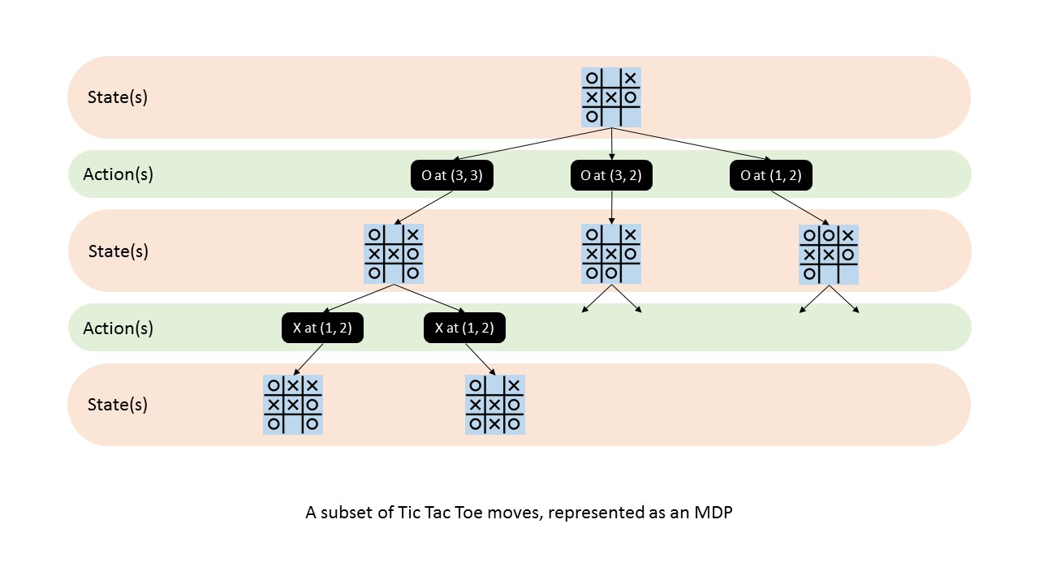
SLIDES
ONLINE PLATFORM
CODE
Serve as study material
Serves as assignments
SLIDES
CODE
Notes:
Slides visually appealing
Left comments in code to indicate where to fill

Slide 6
Slides
Stages of evolution
Understanding Reinforcement Learning in depth from the book
“Reinforcement Learning: An Introduction”,
by A. G. Barto and R. S. Sutton.
Developing and filtering content into word documents, to make it more intuitive and easier to understand.
Creation of slides from word documents.
Adding illustrations and making slides more elegant.
Notes:
1) Often known as “BIBLE” of RL

Slide 7
Code
Stages of evolution
Understanding useful libraries like matplotlib, numpy etc. in python.
Designing a code structure to represent an MDP and its various features and functionalities.
Rapid prototyping of a working code, with essential functionalities and graphics.
(~2000 lines)
Optimising code and adding assignments.
(~1100 lines)
Notes:
1) Needed them to visualize correct concepts
2) Plan

Slide 8
Website
Stages of evolution
Studying the design of various similar websites like “ai.berkeley.edu”, “coursera.org”, “slideshare.com”, “gym.openai.com”
Developing a basic user interface.
Incorporating slides on a separate page, and code as a download link.
Adding final touches and hosting on GitHub.
Notes:
3) Ubuntu compatibility issues

Slide 9
Advantage of P.E.A.R.L.
Coding Assignments
Complete Theory
Free and Open Source
Notes:
1) Not Pacman or CartPole, but MDP (i.e. visualization of concept, not application)
2) Made Barto Sutton more accessible (complicated for beginners).

Slide 10
Future Work
Updating the course with more novel research in Reinforcement Learning (actor-critic, policy search, etc.).
Continuous improvement of coding assignments and explanations based on community review (issue raising and pull requests).
Extension to other areas of Machine Learning like Neural Networks (CNN, RNN etc.), NLP, Fuzzy Clustering etc.
Striving to achieve credibility so that it may be adopted as lab course in other institutions to promote more research in RL.
Notes:
4) Research Community support, lab course UC Berkeley.

Slide 11
Thank You

